Slide 1
Presentation of KM work
Team member：
YAO ZELAING
ZHAO HE

Slide 2
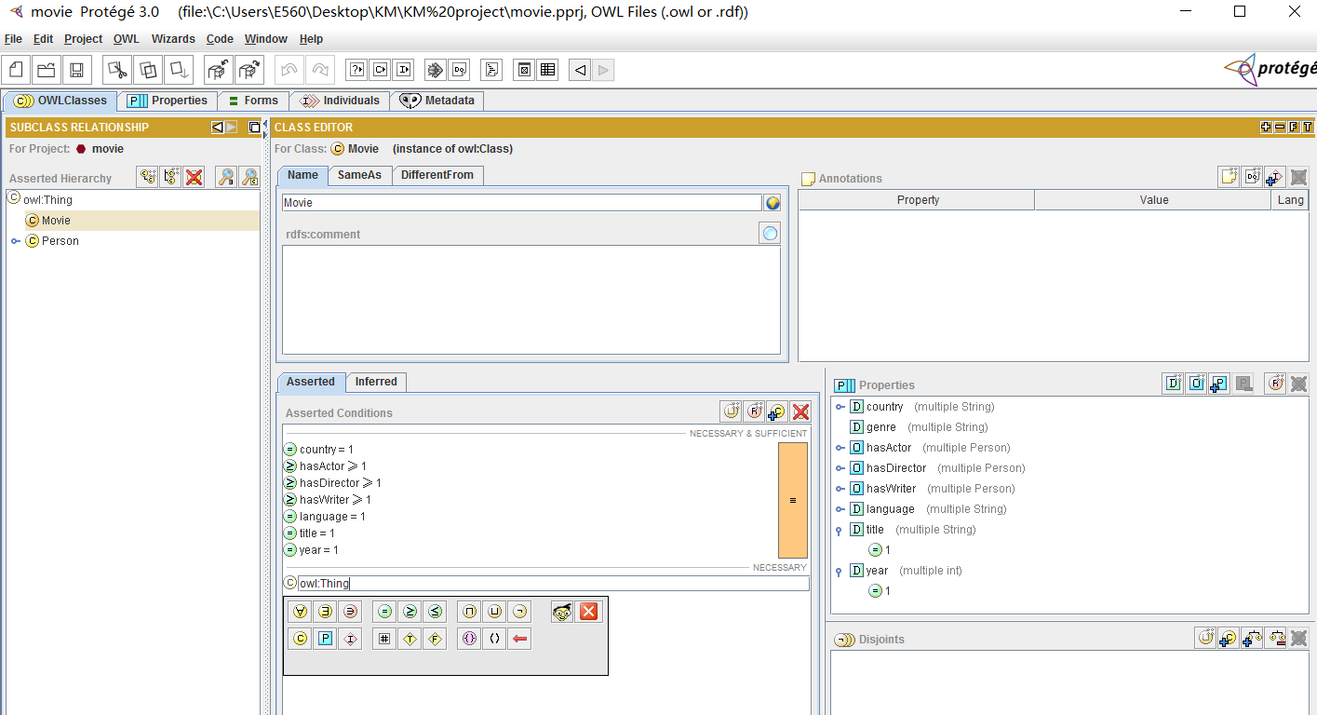

Slide 3
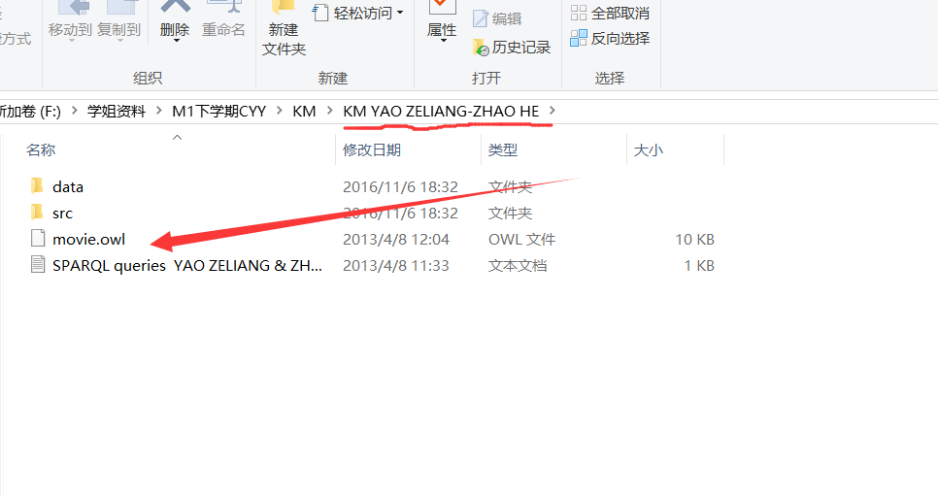
1. The *.owl file generated by Protégé (part I and II)
Open the file
named “KM YAOZELIANG – ZHAOHE”
movie.owl

Slide 4
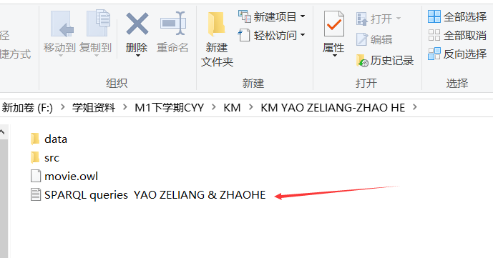
2. A (*.txt or *.doc) file containing the SPARQL queries

Slide 5
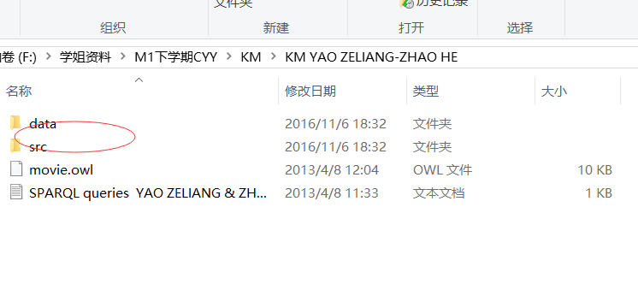
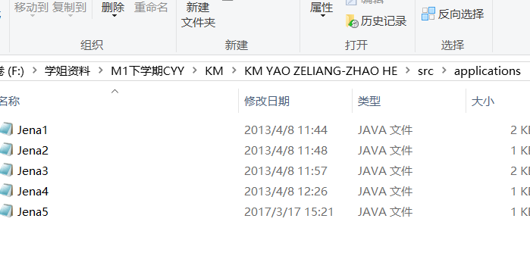
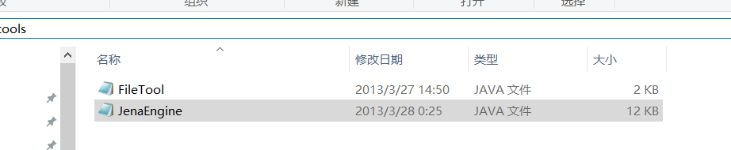
3. The eclipse src and data folders of (part IV and V)
We finished
Jena1
Jena2
Jena3
Jena4
Jena5 no Jena6

Slide 6
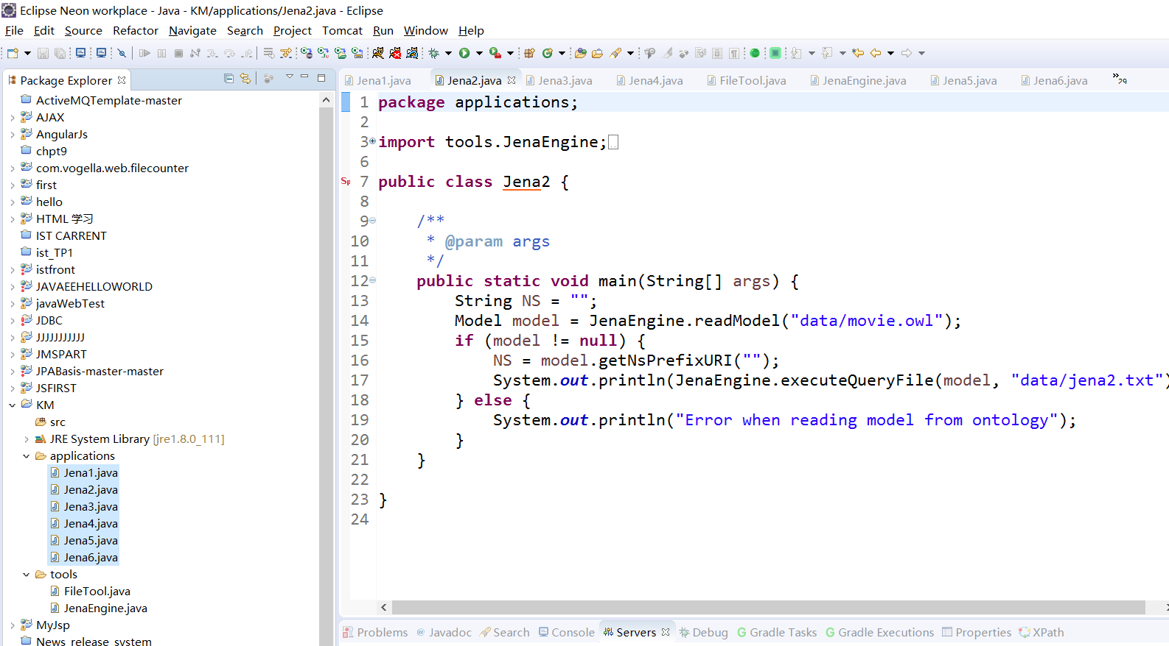

Slide 7
Merci pour votre attention

